Slide 1

Predictive Models
By Nungo Tshidzumba

Slide 2
AGENDA
01
02
03
04
05
06
Logistic Regression /Linear Regression
Data Preprocessing
Features Used in Model
Target Variable
Final Prediction Evaluation
Conclusion

Slide 3
01
Linear
Regression/
Logistic Regression

Slide 4
Linear Regression
vs
Logistic Regression
Linear Regression
Logistic Regression
Purpose: Predicts binary or categorical outcomes (0 or 1, yes or no). Used when the dependent variable is binary (e.g., a yes/no decision).
Usage: Applied when the outcome is binary, such as:
Whether a customer will cancel a flight
If a passenger will book a premium service
Whether an employee will leave (attrition)
Model Output:
Produces probabilities that are then mapped to 0 or 1 based on a threshold (typically 0.5).
Purpose:
Predicts a continuous dependent variable, such as add-on spend or customer spend over time.
Usage: Used when the dependent variable is a continuous number (e.g., housing prices, revenue).
Model Output:
Produces a continuous value (a number) as output, which can range from negative to positive infinity.

Slide 5
02
Data Preprocessing

Slide 6
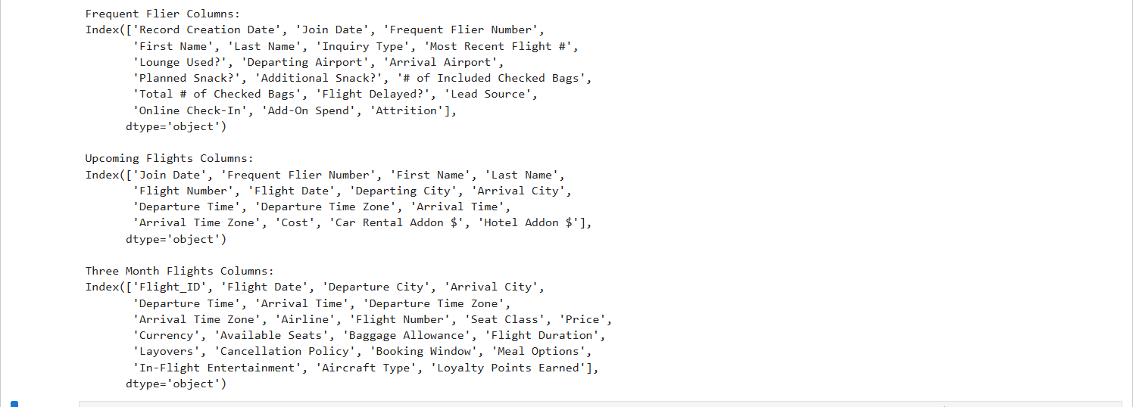
Load all three datasheets

Slide 7
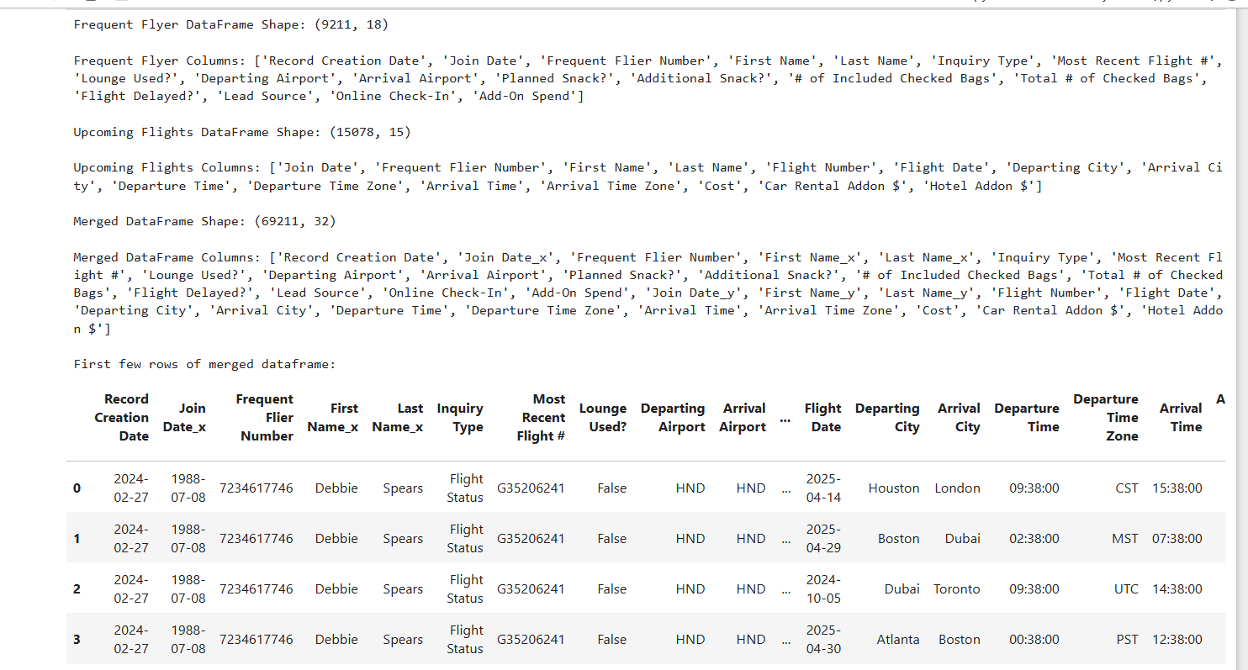
Merge Frequent Flier dataset and Upcoming Flights dataset into one dataframe
This is because they have Frequent Flier Column in common, making it easier for a smooth merge

Slide 8
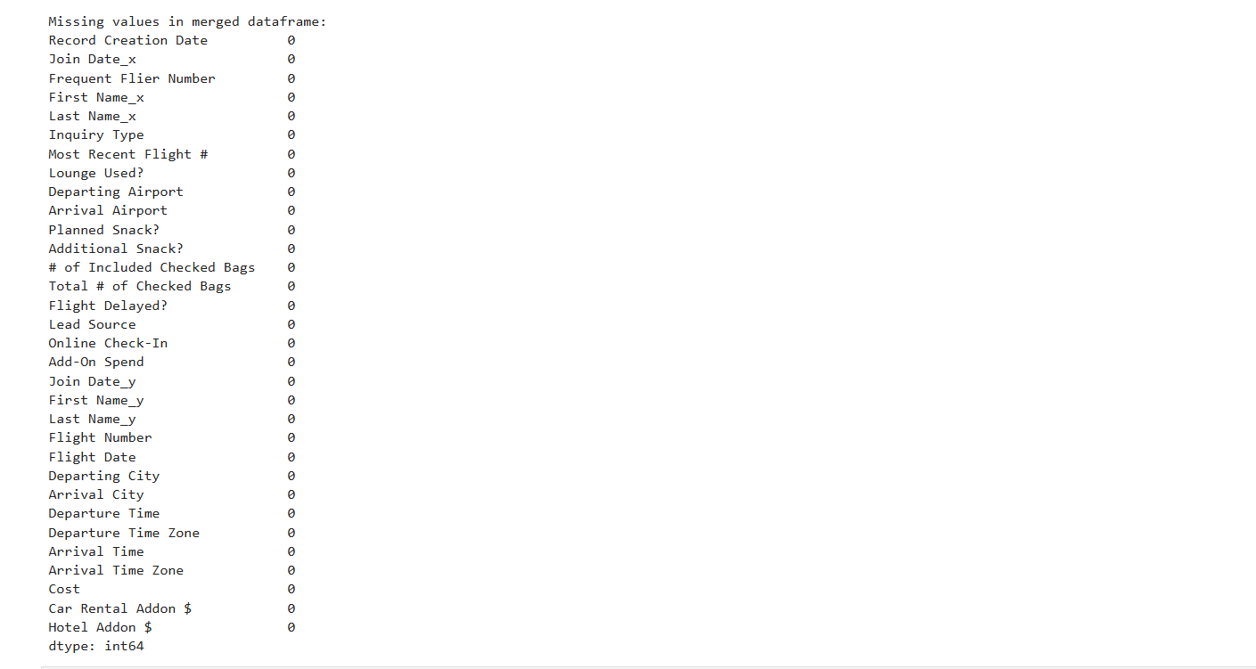
Handle Missing Values
This is to ensure they are no missing values before we build the models.

Slide 9
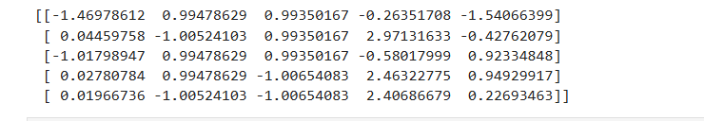
Final Preprocessing
Selected features; Account Age, Lounge Used, Flight Delayed, Add-On Spend and Cost for testing and training
Standardised and scaled numerical features and displayed a list of the data to be used for training.

Slide 10
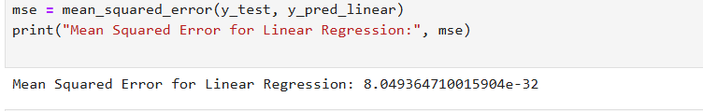
Linear Regression
Linear Regression assumes continuous outputs, which is not suitable for binary classification problems like attrition. A predicted value from linear regression can be any real number, even outside the range [0, 1], making it difficult to interpret probabilities or classify as a "yes" or "no" outcome. In this case, the Mean Squared Error for linear regression was extremely low (close to zero), suggesting overfitting or a poor fit for this type of problem.

Slide 11
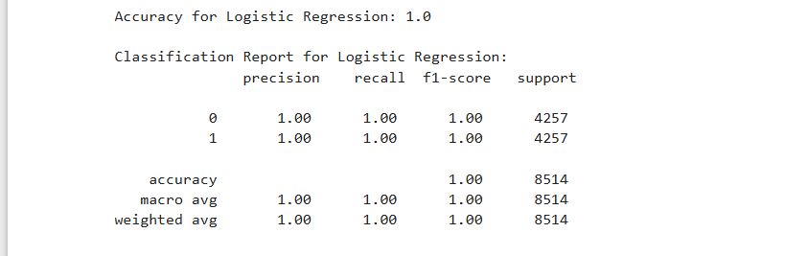
Logistic Regression
Logistic Regression, on the other hand, is specifically designed for binary outcomes. It uses the sigmoid function to constrain predictions between 0 and 1, which aligns perfectly with the need to predict probabilities of a customer staying or leaving. It’s also more robust in handling non-linear decision boundaries and ensures that the predicted output is meaningful for classification tasks.

Slide 12
Model of choice
For this task, logistic regression is the most suitable model because we are dealing with a binary outcome: whether a customer will leave or not. The goal is to predict the probability of attrition, which logistic regression does efficiently by outputting values between 0 and 1. These probabilities can then be converted into binary outcomes, making it the most appropriate model for this task. Linear regression, on the other hand, is designed for continuous outcomes (e.g., sales revenue, prices), which makes it unsuitable for a binary prediction like customer attrition
LOGISTIC REGRESSION MODEL

Slide 13
03
Features Used In Model

Slide 14
Features used in Logistic Regression Model
This is to predict customer attrition rates based on Delta Airlines dataset
Account Age: This feature represents how long a customer has been with the service. It is calculated by subtracting the customer’s join date from the record creation date, resulting in the number of days they’ve been a customer.
Lounge Used?: A binary feature indicating whether the customer used the lounge. We encoded this boolean variable into integers (0 for no, 1 for yes).
Flight Delayed?: A binary feature indicating whether the flight was delayed. This feature was used as a target for prediction. We encoded this boolean variable into integers (0 for no, 1 for yes).
Add-On Spend: This feature represents the amount of money the customer has spent on add-ons, such as additional services or products.
Cost: This represents the total cost associated with the customer, which could be the sum of their subscription or flight costs

Slide 15
04
Target Variable

Slide 16
Target Variable
● Flight Delayed?: This variable represents whether a flight was delayed, but we are using it as a proxy for customer attrition. The target is a binary classification: 0 for no delay (indicating the customer did not leave), and 1 for a delay (indicating attrition or leaving)

Slide 17
05
Final Model Evaluation

Slide 18
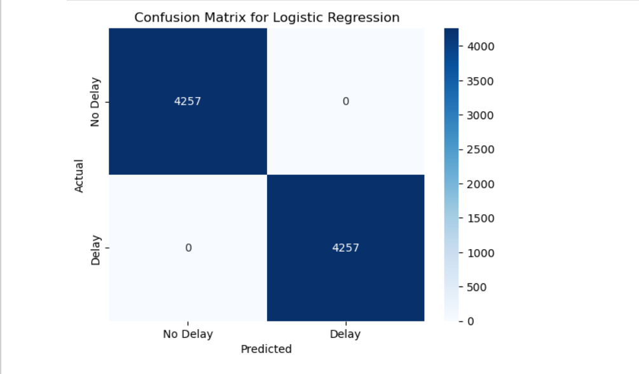
Confusion Matrix
The confusion matrix showed how well the model performed by categorizing the predictions into true positives, true negatives, false positives, and false negatives. This allowed us to calculate performance metrics such as accuracy, precision, and recall.
HOWEVER
A confusion matrix like this could suggest that there could be potential overfitting as such a perfect matrix is rare

Slide 19
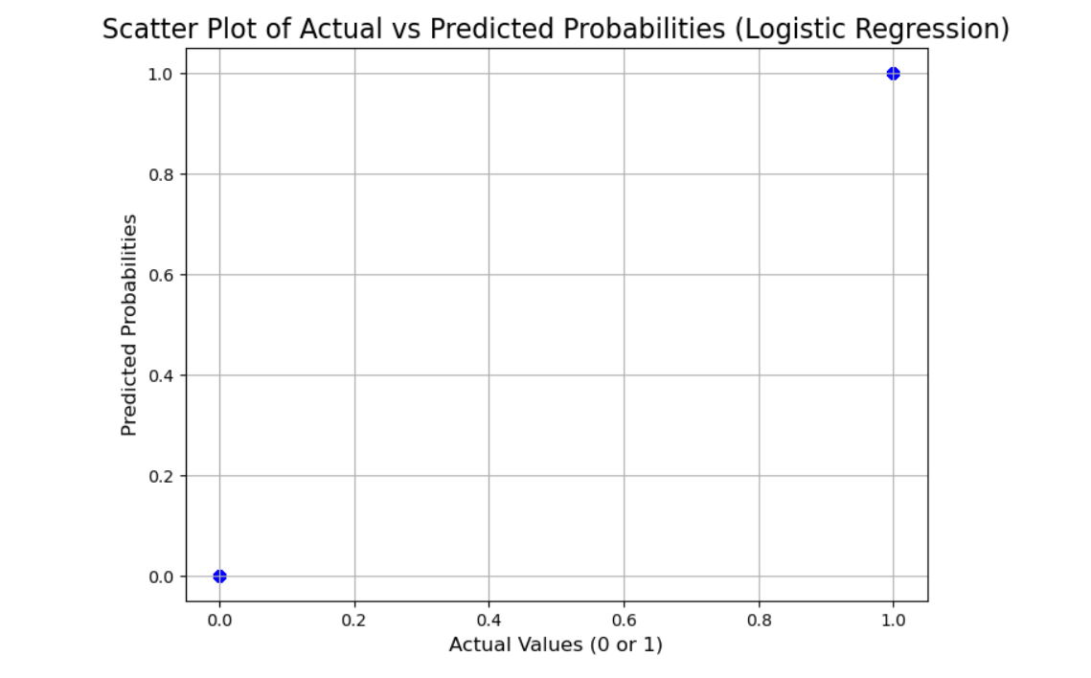
Scatter plot
This scatter plot does not show variety of values, giving the idea that the model fits well and is confident in its predicts
BUT
This could be a sign that there is an overfit issue or maybe a scatter plot is not the best way to predict attrition rates.
SO
We need to check for correlation amongst features
We will use a heat map for this

Slide 20
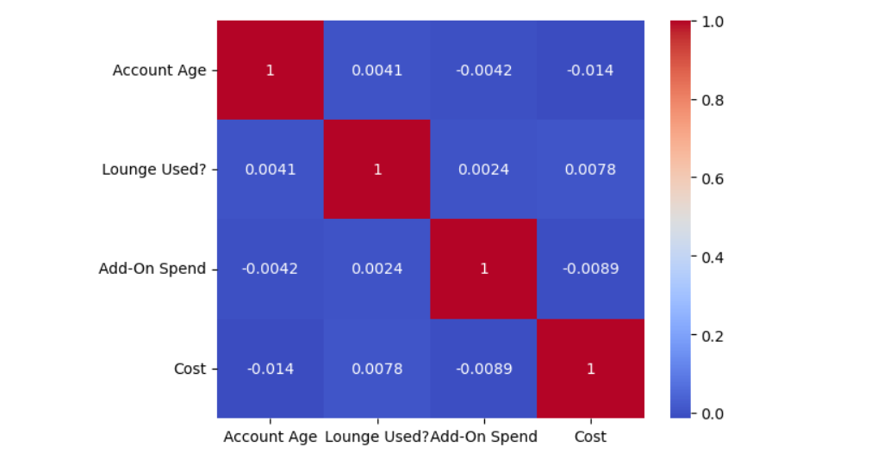
Heat Map
From this we are able to correctly assess each feature from 0 which means the customer is likely to stay or 1 which means the customer is likely to leave

Slide 21
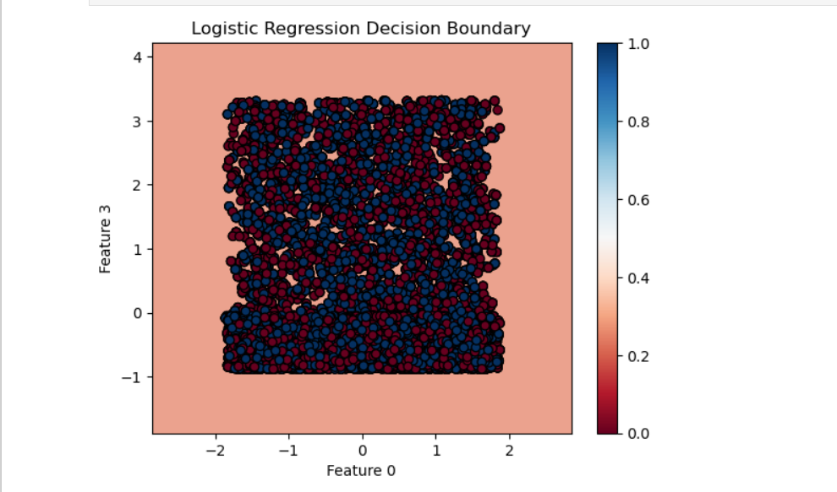
Logistic Regression Decision Boundary
A logistic decision boundary plot provides a richer, more practical visualization of how the model separates classes across the feature space than a scatter plot.
For this decision boundary we used feature 0 which is account age and feature 3 which is add-on spend.
As you can see level 0-0.5 in red represents the customer’s likelihood to stay and level 0.6-1 in blue represents the customer’s likelihood to leave.

Slide 22
06
Conclusion

Slide 23
Why Logistic Regression is the Best Model?
Binary Classification: The task we’re solving is a binary classification problem, where the outcome (attrition or non-attrition) is binary (0 or 1). Logistic regression is specifically designed for such problems, making it the appropriate model choice.
Linear Regression Issue: While linear regression can be used for binary outcomes, it isn't ideal in this case. Linear regression predicts continuous values, which can result in outputs outside the 0-1 range. The mean squared error (MSE) from the linear regression model was extremely low (8.049364710015904e-32), which indicates a poor fit for this binary classification task. This confirms that logistic regression, which is designed to predict probabilities between 0 and 1, is more appropriate

